Slide 1
Data Structure and Algorithm.
Time complexity
By Shohoz Skill

Slide 2
DID YOU KNOW?
Time complexity and Runtime are not the same
Running time refers to the actual time taken by an algorithm to execute for a particular input on a specific machine.
Running time is influenced by various factors such as hardware architecture, programming language, compiler optimizations, and specific input data.

Slide 3
WE WILL TALK ABOUT Time complexity
Time complexity is a way of measuring how the runtime of a program or algorithm grows as the input size increases.
OR,,Time complexity is a theoretical concept that describes the growth rate of an algorithm's running time as the size of the input increases.
It helps us understand how efficient an algorithm is by analyzing how many operations it needs to perform relative to the size of the input. So, the lower the time complexity, the faster the algorithm runs, which is generally what we're aiming for.

Slide 4
Problem - 1
1 print(Hello World!)
Problem - 4
1 print(Hello World!)
2
3 print(Hello World!)
4
5 print(Hello World!)
6
7 print(Hello World!)
8
9 print(Hello World!)
10
Problem - 2
1 int a = 5;
2 print(a);
Problem - 3
1 int a = 5,b = 6;
2 sum = a+b;
3 print(sum);

Slide 5
Problem - 5
1 for(i = 0; i < n; i++)
Or
1 for(i = n; i > 0; i--)
Problem - 7
1 for(i = 1; i < n; i++){
2 //Statement
3 {
Problem - 6
1 for(i = 0; i < n; i++){
2 //Statement
3 }

Slide 6
Problem - 8
1 for(i = 0; i < n; i++){
2 for(j = 0; j < n; j++){
3 //Statement
4 }
5 }
Problem - 9
1 for(i = 1; i < n; i++){
2 //Statement
3 {
4
5 for(j = 0; j < n; j++){
6 //Statement
7 }

Slide 7
Problem - 10
1 for(i = 0; i < n; i=i+2){
2 //Statement
3 }
Or,
1 for(i = n; i > 0; i=i-2){
2 //Statement
3 }

Slide 8
Problem - 11
1 for(i = 1; i < n; i=i*2){
2 //Statement
3 }
or,
1 for(i = n; i > 1; i=i/2){
2 //Statement
3 }

Slide 9
Problem - 12
1 for(i = 0; i < n; i=i*2){
2 for(j = 0; j < n; j=j*2){
3 //Statement
4 }
5 }
Problem - 13
1 for(i = 1; i < n; i=i*2){
2 //Statement
3 }
4
5 for(j = 0; j < n; j=j/2){
6 //Statement
7 }

Slide 10
Problem - 14
1 for(i = 3; i <= n; i=i*i){
2 //Statement
3 }
Or,
1 for(i = n; i >= 3; i=i/i){
2 //Statement
3 }

Slide 11
Problem - 15
1 for (i = 0; i*i<n; i++){
2 //Statement
3 }
Problem - 16
1 for(i = 0; i*i < n; i++){
2 for(j = 0; j*j < n; j++){
3 //Statement
4 }
5 }

Slide 12
Different types of time of Time complexity
1.n 1.for(i = 0; i < n;i++)
2.for(i = n; i > 0;i--)
2.log(n) 1.for(i = 1;i < n;i=*c)
2.for(i = n;i > 1;i=/c)
3.(n/2) 1.for(i = 0;i < n;i=+c)
2.for(i = n;i > 0;i=-c)
4.(sqrt(n)) 1.for (i = 0; i*i<n; i++)
5.(loglog(n)) 1.for(i = c; i <= n; i=i*i)
2.for(i = n; i >= c; i=i/i)

Slide 13
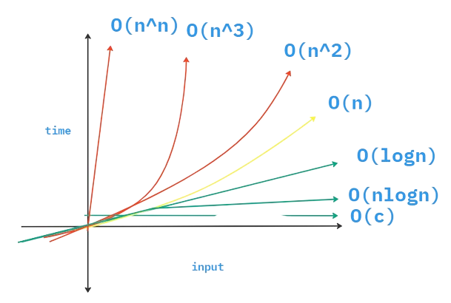
Different types of time of Time complexity

Slide 14
For Loop
1 for(i = 0;i < n; i++){
2 //Statement
3 }
D0-While Loop
1 i = 0;
2 do{
3 //Statement
4 i++;
5 }while(i < n)
While Loop
1 i = 0;
2 while(i < n){
3 //Statement
4 i++;
5 }

Slide 15
Problem - 17
1 for(i = 0; i < n; i=i+2){
2 for(j = n; j > 1; j=j/2){
3 //Statement
4 }
5 }

Slide 16
Problem - 18
1 i = 1
2 k = 1
3 while(){
4 k=k+i;
5 i++;
6 }
or,
1 for (i = 0; i*i<n; i++){
2 k=k+i;
3 i++;
4 }

Slide 17
Problem - 19
1 for (i = 0; i < n; i++){
2 for (j = 0; j < n; j++){
3 a=a+j;
4 }
5
6 for (k = 0; k < n; k++){
7 b=b+k;
8 }

Slide 18
Problem - 20
1 for (i = 0; i < n; i++){
2 for (j = n; j > i; j--){
3 a=a+i+j;
4 }

Slide 19
Problem - 21
1 for(i = n; i>1; i/=3)
2 for(j = 0; j <n ; j+=2)
3 print(Hello)
4 }
5 }
6
7 for( k = 3;k < n; k++)
8 print(hello)
9 }

Slide 20
Problem - 22
1 void fun(n){
2 while(i < n){
3 j = n;
4 while(j>0)
5 j = j / 2
6 i = 2 * i
7 }
8 }
9 }

Slide 21
Thank you
Do you have any questions?
-> comment down below.
Like. share. subscribe

